Slide 1
Connectivity
Course Code: 00090
Course Title: Discrete Mathematics
Dept. of Computer Science
Faculty of Science and Technology
Lecturer No: | 17 | Week No: | 10 | Semester:
Lecturer: | Name & email

Slide 2
Lecture Outline
Connectivity 8.4
Paths
Circuits
Simple path and Simple circuits
Connectedness in undirected Graph
Connectedness in directed Graph
Graph Isomorphism : checking simple circuit of certain length

Slide 3
Objectives and Outcomes
Objectives: To understand the terms path, circuit, simple path, simple circuit; to understand connectedness in undirected and directed graphs, to determine whether two graphs are isomorphic.
Outcomes: The students are expected to be able to explain path, circuit, simple path, simple circuit; be able to determine whether an undirected graph is connected or whether a directed graph is weakly or strongly connected; be able to determine whether two graphs are isomorphic.

Slide 4
Paths
A path is a sequence of edges that begins at a vertex of a graph and travels from vertex to vertex along edges of the graph.

Slide 5
Paths
Definition1: Let n be a nonnegative integer and G an undirected graph. A path of length n from u to v in G is a sequence of n edges e₁, e₂ , …., e_{n} of G such that
e₁ is associated with {x₀, x₁}, e₂ is associated with {x₁, x₂ }, and so on, with e_{n} associated with {x_{n-1}, x_{n} }, where x₀=u and x_{n}=v.
The path is a circuit if it begins and ends at the same vertex, that is, if u = v, and has length greater than zero.
The path or circuit is said to pass through the vertices x_{1,} x_{2, …,} x_{n-1} or traverses the edges e₁, e₂ , …., e_{n} .
A path/circuit is simple if it does not contain the same edge more than once.

Slide 6
Paths in Directed Graph
Same as in undirected graphs, but the path must go
in the direction of the arrows.

Slide 7
Connectedness in Undirected Graphs
An undirected graph is called connected if there is a path between every pair of distinct vertices of the graph

Slide 8
Example 2 (p.561)
In the simple graph shown in Figure, a , d, c, f, e is a simple path of length 4, because {a , d}, {d, c } , {c, f}, and { f, e} are all edges.
However, d, e, c, a is not a path, because {e, c} is not an edge.
Note that b, c, f, e, b is a circuit of length 4 because {b, c}, {c, f}, {f, e}, and {e, b} are edges, and this path begins and ends at b.
The path a, b, e, d, a, b, which is of length 5, is not simple because it contains the edge {a, b} twice.

Slide 9
Example 6 (p.563)
Figure 3: The Graphs G ₁ and G₂
The graph G _{l} in Figure 3 is connected, because for every pair of distinct vertices there is a path between them.
However, the graph G ₂ in Figure 3 is not connected. For instance, there is no path in G2 between vertices a and d.

Slide 10
Connectivity
Connectivity is a basic concept of graph theory. It defines whether a graph is connected or disconnected. Without connectivity, it is not possible to traverse a graph from one vertex to another vertex.
A graph is said to be connected graph if there is a path between every pair of vertex. From every vertex to any other vertex there must be some path to traverse. This is called the connectivity of a graph.
A graph is said to be disconnected, if there exists multiple disconnected vertices and edges.
Graph connectivity theories are essential in network applications, routing transportation networks, network tolerance etc.

Slide 11
Connectivity
Question: Which of the following graphs are connected?
1
2
3
4

Slide 12
Connectivity
Answer: First and second are disconnected. Last one is connected.
1
2
3
4

Slide 13
Connected Components
A connected component of a graph G is a connected subgraph of G that is not proper subgraph of another connected subgraph of G.
A connected component of a graph G is a maximal connected subgraph of G.
  A graph G that is not connected has two or more connected components that are disjoint and have G as their union
Connected is usually associated with undirected graphs (two way edges): there is a path between every two nodes.

Slide 14
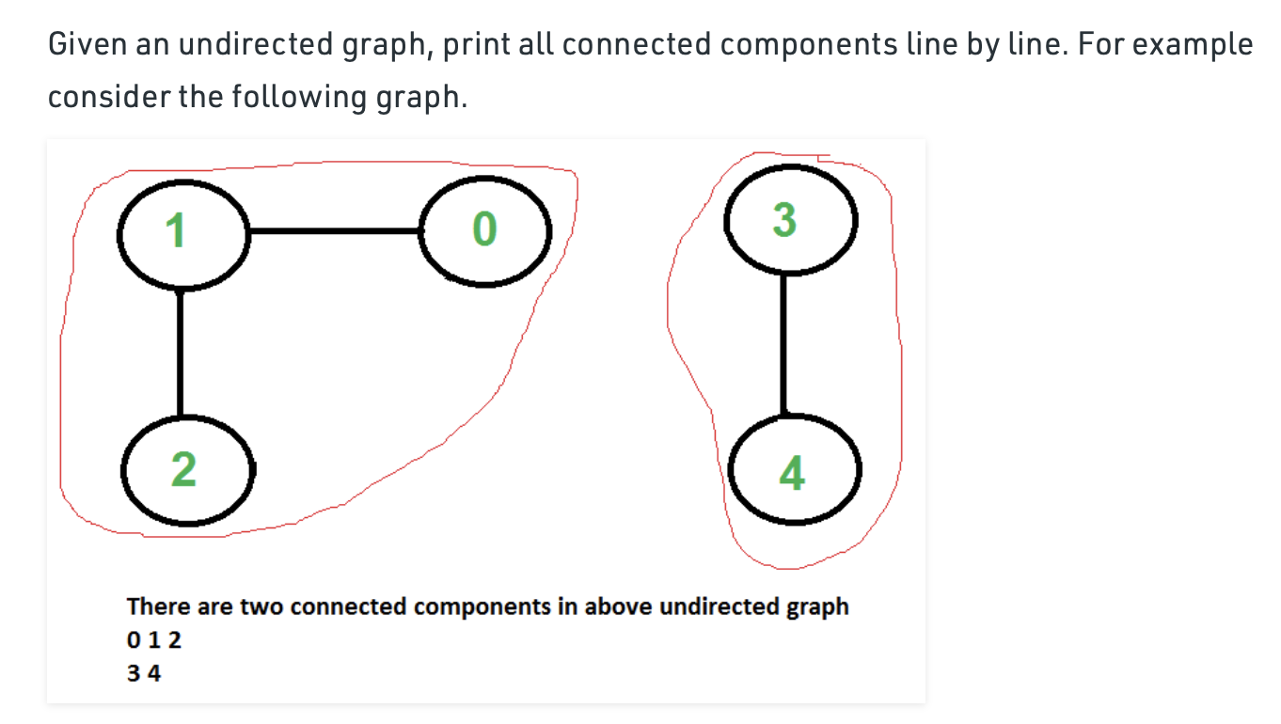
Connected Components

Slide 15
Connected Components
Definition: A connected component in a graph G is a set of vertices such that all vertices in the set are connected to each other and every possible connected vertex is included.
Question : What are the connected components of the following graph?
1
6
2
7
8
5
3
4

Slide 16
Connected Components
Answer: The connected components are {1,3,5}, {2,4,6}, {7} and {8} as one can see visually by pulling components apart:
1
6
2
8
7
5
3
4

Slide 17
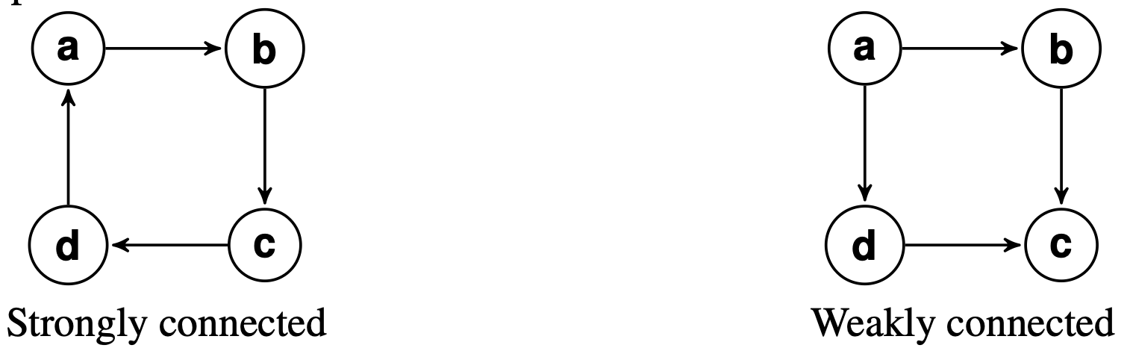
Connectedness in Directed
Graphs
Connectedness in directed graph
A directed graph is strongly connected if there is a path from a to b and from b to a whenever a and b are vertices in the graph.
A strongly connected component (SCC) of a directed graph is a maximal strongly connected subgraph.
A directed graph is weakly connected if there is a path between every two vertices in the underlying undirected graph. (underlying undirected graph means if we remove the directions)

Slide 18
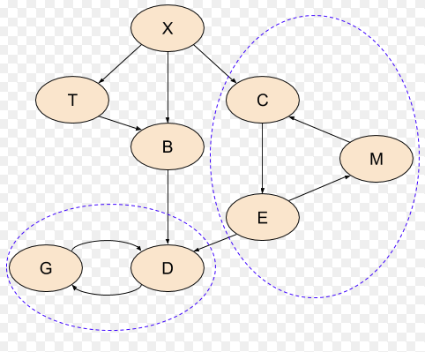
In the picture above, CME and GD are strongly connected components. Every node/vertex of CME and GD is reachable from other nodes of CME and GD respectively. In CME, C is reachable from E through M and directly from M. In this way M, E is also reachable from others.
a weakly connected component is a directed subgraph that is unreachable from other nodes/vertices of a graph or subgraph. In the picture above X, XTB, etc are weakly connected components. For example: in the graph above X is a weakly connected component, because x is unreachable from any other node of the graph without violating edge direction.

Slide 19
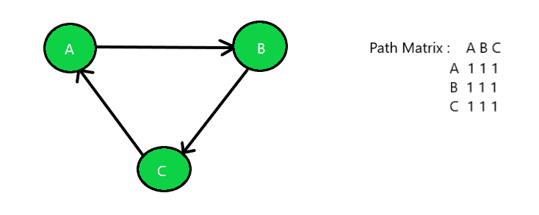
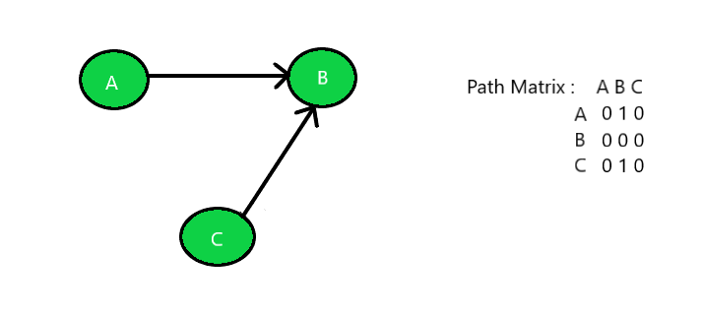
Strongly connected ( directed path exist between a to b, b to a, a to c, c to a, b to c and c to a
Weakly connected

Slide 20
EXAMPLE: Are the directed graphs G and H shown in Figure strongly connected? Are they weakly connected?
Weakly Strongly
Connected Connected
G H
H is strongly connected because there is a path between any two vertices in this directed graph. Hence, H is also weakly connected.
The graph G is not strongly connected. There is no directed path from a vertex to other vertex in this graph.

Slide 21
Example
Graph G is strongly connected (hence G is also weakly connected). Graph H is not strongly connected, however H is weakly connected.
a b a b
    c
  c
  e d e d
  Graph G Graph H

Slide 22
Paths and Isomorphism
There are several ways that paths & circuits can help determine whether two graphs are isomorphic.
  For example, the existence of a simple circuit of a particular length is a useful invariant that can be used to show that two graphs are not isomorphic
A useful isomorphic invariant for simple graphs is the existence of a simple circuit of length k, where k is a positive integer greater than 2.

Slide 23
Graph Isomorphism – Example
Determine whether the graphs G and H are isomorphic.
G H
v₂
u₂
v₁
v₃
u₁
u₃
v₅
v₄
u₅
u₄

Slide 24
Solution
At first, you check all the graph invariants between
the two graphs you know so far. If there is any mismatch, then
the graphs are not isomorphic.
However, if all the graph invariants are same, then you go for
mapping (i.e., mapping the vertices of one graph to another).
Here, all the graph invariants are same (you check it!).
Now you go for mapping…
f (v₁) = u₁ , f (v₂) = u₃ , f (v₃) = u₅ , f (v₄) = u₂ , f (v₅) = u₄
The function f is bijective (i.e., one-to-one as well as onto).
So, the graphs G and H are isomorphic.

Slide 25
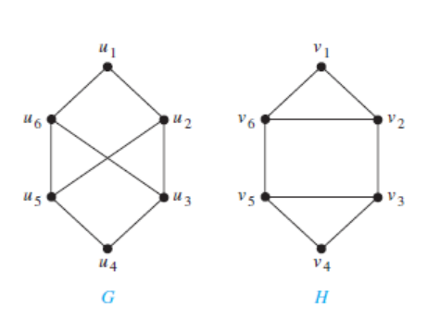
Example 14(p.565): Determine whether the graphs G and H shown in Figure 8 are isomorphic.
Figure 8

Slide 26
Solution
Both G and H have six vertices and eight edges.
Each has four vertices of degree three, and two vertices of degree two.
So, the three invariants –number of vertices, number of edges, and degrees of vertices —all agree for the two graphs. [Note: you must check other graph invariants too]
However, H has a simple circuit of length three, namely, v₁, v₂, v₆, v₁ , whereas G has no simple circuit of length three, as can be determined by inspection (all simple circuits in G have length at least four).
Because the existence of a simple circuit of length three is an isomorphic invariant, G and H are not isomorphic.

Slide 27
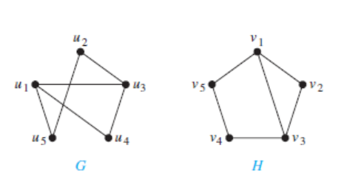
Example 15 (p.566) : Determine whether the graphs G and H shown in Figure 9 are isomorphic.
Figure 9

Slide 28
Solution
Both G and H have five vertices and six edges.
Each has two vertices of degree three, and three vertices of degree two.
Both have a simple circuit of length three, a simple circuit of length four, and a simple circuit of length five.
Because all these isomorphic invariants agree here, so
G and H may be isomorphic.
…..continued to next slide

Slide 29
Finding of possible isomorphism:
………. we will follow paths that go through all vertices so that the corresponding vertices in the two graphs have the same degree.
For example, the paths u₁, u₄,u₃, u₂, u₅ in G and v₃, v₂, v₁, v₅, v₄ in H both go through every vertex in the graph; start at a vertex of degree three; go through vertices of degrees two, three, and two, respectively; and end at a vertex of degree two.
By following these paths through the graphs, we can define the mapping f with
  f (u₁) = v₃
  f (u₂) = v₅
  f (u₃) = v₁
  f (u₄) = v₂
  f (u₅) = v₄
It shows that f is an isomorphism, so G and H are isomorphic.

Slide 30
Books
Rosen, K. H., & Krithivasan, K. (2012). Discrete mathematics and its applications: with combinatorics and graph theory. Tata McGraw-Hill Education. (7th Edition)
Liu, C. L. (1986). Elements of discrete mathematics. Tata McGraw-Hill Education.

Slide 31
References
Discrete Mathematics, Richard Johnsonbaugh, Pearson education, Inc.
Discrete Mathematical Structures, Bernard Kolman, Robert C. Busby, Sharon Ross, Prentice-Hall, Inc.
SCHAUM’S outlines Discrete Mathematics(2nd edition), by Seymour Lipschutz, Marc Lipson
Open University Catalonia https://www.csd.uoc.gr/~hy583/papers/ch17.pdf
Duke University https://www2.cs.duke.edu/courses/spring11/cps102/notes/lec23.pdf

